Slide 1
Dynamic Homotopy for Ill-Conditioned
Power Flow: Reproduction and Improvements
Based on A. Lima-Silva and F. D. Freitas, "Exploring a Dynamic Homotopy Technique to Enhance the Convergence of Classical Power Flow Iterative Solvers in Ill-Conditioned Power System Models", Energies 17(18):4642, 2024
2105039, 2105040, 2105057, 2105058, 2105060
CSE 402 Numerical Analysis Sessional
Notes:
We implemented the paper from scratch in Python, reproduced its results, and then tested changes to the method. First the paper, then our implementation and reproduction, then the improvements.

Slide 2
Power flow as a nonlinear system
Steady state of a grid: solve g(x) = 0, g : ℝⁿ → ℝⁿ
Each bus gives a power balance equation
ΔS = V · conj(Y V) − (generation − load)
Unknowns x: voltage angles θ (PV and PQ buses) and magnitudes |V| (PQ buses)
Flat start x₀: all θ = 0, all |V| = 1
Newton from the flat start diverges on all 5 large grids of the paper
Lima-Silva & Freitas (2024): reproduction and improvements
2
Notes:
For this course the grid is simply a source of one large sparse nonlinear system. Y is the bus admittance matrix. PV buses have a generator that fixes the magnitude, so only the angle is unknown there. The flat start is the natural guess when nothing is known.

Slide 3
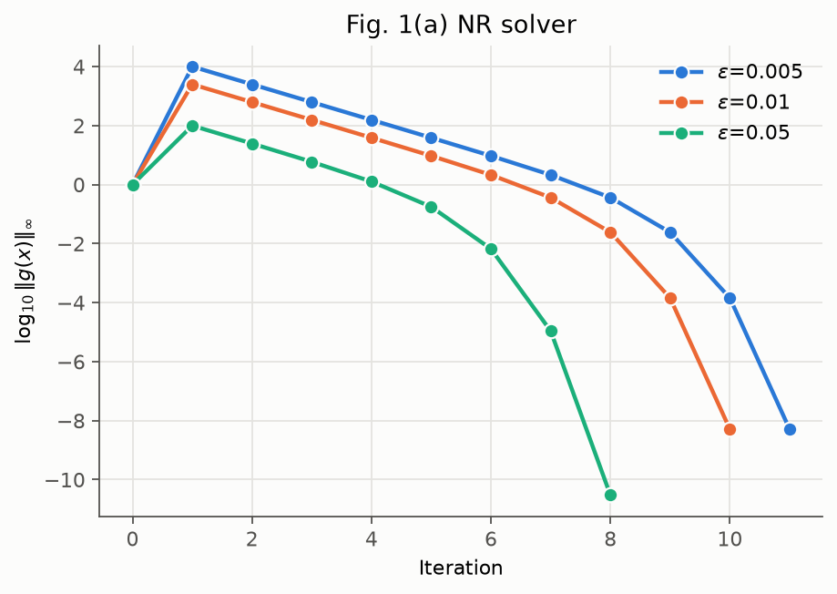
Newton-Raphson and why it fails here
xᵢ₊₁ = xᵢ − J(xᵢ)⁻¹ g(xᵢ)
One sparse LU of J per iteration
Stop at ‖g‖ < 10⁻⁸, at most 10 iterations
Quadratic convergence, but only locally
At the flat start J is nearly singular: |λ|max / |λ|min up to 1.2 × 10⁸
Lima-Silva & Freitas (2024): reproduction and improvements
3
Notes:
The figure is our reproduction of the paper's Figure 1a: Newton on the paper's 2 by 2 example, started near a point where J is singular. The first step jumps the mismatch up by several orders of magnitude before it recovers. On the large grids it never recovers. The eigenvalue ratio was measured with our power method and inverse iteration.

Slide 4
The fixed-point homotopy
Start from an easy problem with a known root and deform it into g:
G(x, t) = t · g(x) + (1 − t) · K (x − x₀), t ∈ [0, 1]
t = 0: G = K (x − x₀), root x₀ (the flat start)
t = 1: G = g(x), the real problem
In between, the root moves along a smooth path x(t)
K weights the easy part; the paper uses K = 10⁻⁴
Lima-Silva & Freitas (2024): reproduction and improvements
4
Notes:
Static continuation would stop at several values of t and solve each one fully with Newton. The paper does dynamic continuation instead: it turns the path into an ODE and takes only a few cheap steps.

Slide 5
From the path to an ODE
G(x(t), t) = 0 along the path. Differentiating with the chain rule:
Gₓ ẋ + Gₜ = 0
⇒ ẋ = −Gₓ⁻¹ Gₜ ; x(0) = x₀
with
Gₓ = t J(x) + (1 − t) K I
Gₜ = g(x) − K (x − x₀)
Root finding becomes an initial value problem
Each evaluation of ẋ is one sparse solve with Gₓ, i.e. one LU factorization
Lima-Silva & Freitas (2024): reproduction and improvements
5
Notes:
Moving x changes G by Gx dx and moving t changes it by Gt dt; along the path the two cancel. Gx is the Jacobian plus a multiple of the identity, so it stays sparse. LU counts dominate run time and do not depend on the machine, so they are a fair cost measure.

Slide 6
Integration schemes used by the paper
With f(x, t) = −Gₓ(x, t)⁻¹ Gₜ(x):
Scheme | Step | LUs | Order
Forward Euler | xₖ₊₁ = xₖ + Δt f(xₖ, tₖ) | 1 | 1
Backward Euler | xₖ₊₁ = xₖ + Δt f(xₖ, tₖ₊₁) | 1 | 1
RK2 | xₖ₊₁ = xₖ + (Δt/2)(k₁ + k₂) | 2 | 2
BE is implicit; the paper does a single fixed-point iteration from xₖ
The only difference from FE is that Gₓ is evaluated at tₖ₊₁ instead of tₖ
Lima-Silva & Freitas (2024): reproduction and improvements
6
Notes:
True backward Euler solves x_k+1 = x_k + dt f(x_k+1, t_k+1). Writing it as a fixed point problem and iterating once from x_k keeps x_k but uses the new time inside Gx. That single change is what makes the method work, as the next slide shows.

Slide 7
The first step: forward vs backward Euler
At t = 0, x = x₀ we have Gₜ = g(x₀). The two schemes differ only in Gₓ.
Forward Euler
Backward Euler
Gₓ(x₀, 0) = K I
Gₓ(x₀, Δt₀) = Δt₀ J + (1 − Δt₀) K I
x₁ = x₀ − (Δt₀/K) g(x₀) = x₀ − 50 g(x₀)
x₁ = x₀ − (J + δ I)⁻¹ g(x₀), δ ≈ K/Δt₀ = 0.02
The ODE is stiff at the start, so the implicit scheme is the stable one.
Lima-Silva & Freitas (2024): reproduction and improvements
7
Notes:
Dividing the BE step by dt0 shows it is exactly a Newton step with J + delta I, delta = (1 - dt0) K / dt0, which is about 0.02 for the paper's values. The shift moves the small eigenvalues of J away from zero. For an eigen-direction with eigenvalue lambda, FE multiplies the error by 1 - lambda/delta, which is huge when lambda is much larger than delta, while BE multiplies it by delta/(lambda + delta). The 532 to 65 numbers are case18482; the 1e12 is from the paper's Section 4.2.1, which we reproduced.

Slide 8
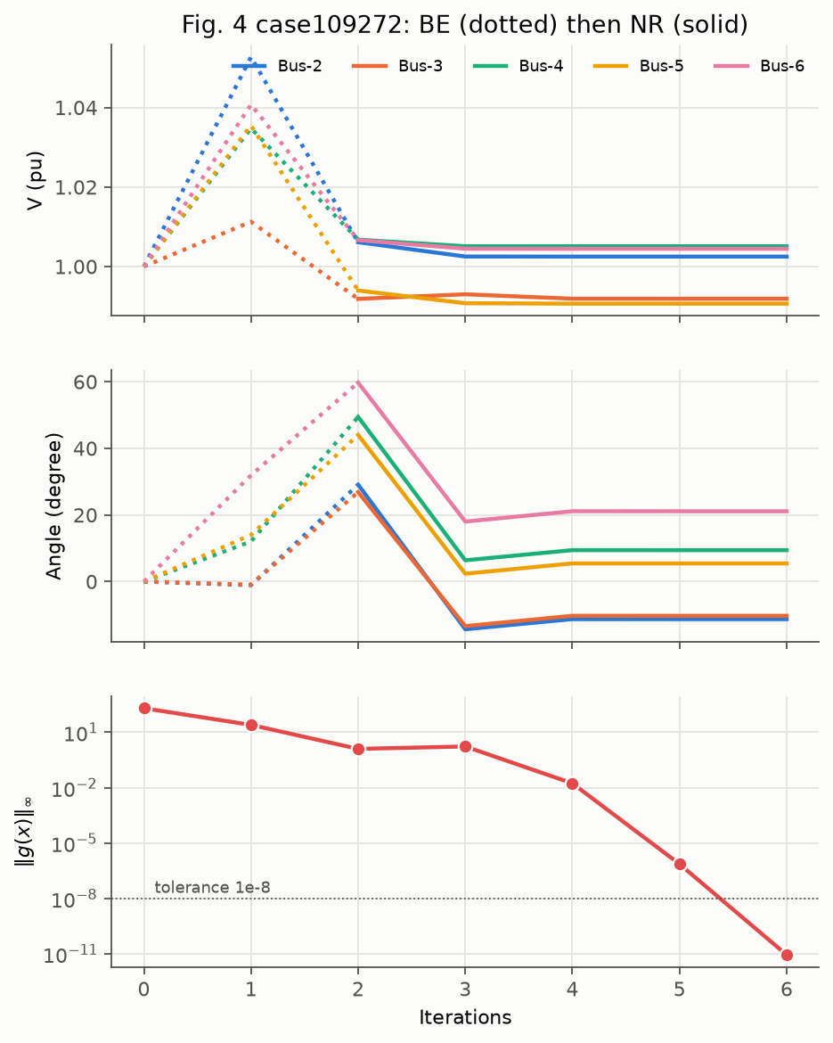
The complete method
Start at the flat start x₀, t = 0
BE step to t = 0.005
BE step to t = 1
Newton-Raphson from x(1)
K = 10⁻⁴, Δt₀ = 0.005, path {0, 0.005, 1}
Cost: 2 LUs for the path plus about 4 Newton iterations, where Newton alone diverges. The paper also finishes with FDXB instead of Newton.
Lima-Silva & Freitas (2024): reproduction and improvements
8
Notes:
The figure is our reproduction of the paper's Figure 4 on the 109,272-bus grid. Dotted lines are the two BE steps, solid lines the Newton iterations. Bus 6 ends at 1.0045 pu and 21.1 degrees, the same as in the paper. The ODE is not solved accurately; it only has to hand Newton a point it can converge from. FDXB is the fast decoupled method, which factorizes two constant matrices once.

Slide 9
Reproduction of the paper's results
Example, Table 4 (case18482, backward Euler): ‖g‖ along the path, then Newton
 | t = 0 | 0.005 | 0.01 | 0.51 | 1 | NR 1 | NR 2 | NR 3
Ours | 533 | 65 | 33 | 7.2 | 3.7 | 0.042 | 1.5×10⁻⁵ | 9.3×10⁻¹²
Paper | 532 | 65 | 33 | 7.2 | 3.7 | 0.04 | 1.5×10⁻⁵ | 1.0×10⁻¹¹
Tables 2 to 5: 246 of 255 values within a factor of 2 of the paper
FE and RK2 blow up at the same places as in the paper
Table 7 iteration counts match on the 5 large grids except in 2 cells
Figures 4 and 5: same voltage paths and final state
Lima-Silva & Freitas (2024): reproduction and improvements
10
Notes:
Each table and figure of the paper has its own script, and each cell is printed as ours next to the paper's. Where FE and RK2 blow up they do so at the same step, only the size of the blow-up differs. The two Table 7 differences are GSH-NR on case27318 and BE with FDXB on case109272. Two small limit cases only match on a 100 MVA base although their files store 10 MVA.

Slide 10
Checking which root is reached
Power flow equations have several roots
‖g(x)‖∞ < 10⁻⁸ shows that x is a root, not that it is the intended one
Reference root V(ref): Newton from the initial guess stored in the case file
A run counts as correct only if
max over buses of |V − V(ref)| < 10⁻⁴ pu
All converged runs in the paper's Table 7 pass
On our wider test set, 14 of the 141 converged runs of the paper's method reached a different root
Lima-Silva & Freitas (2024): reproduction and improvements
11
Notes:
We compare complex bus voltages rather than x, so the test does not depend on how angles are stored. This check is used for every result that follows.

Slide 11
Evaluation setup for the improvements
34 grids: the paper's 9 plus 25 more from the same Zenodo records
5 settings of (Δt₀, K), path {0, Δt₀, 1}, giving 170 runs per configuration:
Setting | Δt₀ | K
S1 (paper) | 0.005 | 10⁻⁴
S2, S3 (paper, Sec. 4.4) | 0.05, 0.1 | 10⁻³, 2×10⁻³
S4 (weak K), S5 (strong K) | 0.005 | 10⁻⁵, 10⁻³
Solved: Newton converges within 10 iterations and reaches the reference root
Cost: LU factorizations per run. Each change is a separate on/off switch
Lima-Silva & Freitas (2024): reproduction and improvements
12
Notes:
We tested ten changes suggested by the paper, its references and our proposal presentation. With all switches off the code gives exactly the paper's method, which a test checks. Three of the changes clearly help; they are on the next slides.

Slide 12
Improvement 1: predictor-corrector
Predictor: the BE step gives a point x̃ near, but not on, the path
Corrector: one Newton step on G(x, tₖ₊₁) = 0 at the fixed new time
xₖ₊₁ = x̃ − Gₓ(x̃, tₖ₊₁)⁻¹ G(x̃, tₖ₊₁)
Standard scheme of continuation methods; one extra LU per step
Result: 152 of 170 solved (paper: 127)
Wrong roots drop from 14 to 2; 8.43 LUs per run (paper: 8.04)
Lima-Silva & Freitas (2024): reproduction and improvements
13
Notes:
Staying close to the path keeps the method on the branch that starts at x0, which is why the wrong roots nearly disappear. It also makes the result almost independent of dt0. In the code it is a wrapper that works with any step rule.

Slide 13
Improvement 2: optimal multiplier (Iwamoto)
Damped Newton: take x + μΔx. With a = g(x), c = g(x + Δx) and JΔx = −a:
g(x + μΔx) ≈ (1 − μ) a + μ² c
Minimising the squared norm gives a cubic in μ:
2(c·c) μ³ − 3(a·c) μ² + (a·a + 2 a·c) μ − a·a = 0
No extra LU; μ → 1 near the root, so quadratic convergence is kept
Alone: 7.14 LUs per run instead of 8.04 (about 11% fewer), 143 solved
With the corrector: 152 solved at 7.57 LUs
Lima-Silva & Freitas (2024): reproduction and improvements
14
Notes:
This is the paper's reference 10, Iwamoto and Tamura. The cubic is solved exactly with a polynomial root finder, and we keep the real root in (0, 2] with the smallest model residual. On its own it saves LUs but does not prevent wrong roots (12). Combined with the corrector it gives the best trade-off in our study.

Slide 14
Improvement 3: Richardson step control
Compare one step of size h with two of size h/2 (method of order p):
err ≈ ‖y(h/2) − y(h)‖∞ / (2ᵖ − 1)
accept if err ≤ tol, y ≈ y(h/2) + (y(h/2) − y(h)) / (2ᵖ − 1)
next h = 0.9 · h · (tol / err)^(1/(p+1))
151 of 170 solved; 156 with the multiplier, the most of any configuration
Solves some of the hardest cases, at 20 to 30% more LUs
Under error control BE is still cheapest: 10.6 LUs vs FE 37, RK2 48, RK4 87
Lima-Silva & Freitas (2024): reproduction and improvements
15
Notes:
Our proposal presentation asked for steps chosen by an error estimate instead of by hand. The local error of an order p method is about C h^(p+1), so the difference between one full step and two half steps estimates it. The kept point is the extrapolated value, and the next step is scaled from the error. A path that needs more than 150 LUs is stopped. It is the only change that solves case6024 at the paper's own setting. The comparison of integrators under error control confirms the paper's claim that backward Euler is the right choice.

Slide 15
Results on the 170 runs
Configuration | Solved | Wrong root | LUs per run
Paper's method | 127 | 14 | 8.04
Corrector | 152 | 2 | 8.43
Multiplier | 143 | 12 | 7.14
Multiplier + corrector | 152 | 3 | 7.57
Richardson (BE) | 151 | - | 10.6
Multiplier + Richardson | 156 | 8 | 9.75
Corrector: fewer wrong roots. Multiplier: lower cost. Richardson: the hardest cases
Multiplier + corrector solves 25 more runs than the paper at lower cost
Lima-Silva & Freitas (2024): reproduction and improvements
16
Notes:
All numbers come from one study over the same 170 runs. Solved means correct root within 10 Newton iterations. Multiplier plus corrector is what we would use by default; Richardson is worth it when a case is known to be hard.

Slide 16
Changes that did not help
Change | Solved | Reason
RK4 with fixed steps | 13 | Explicit; higher order does not fix stiffness
BE with 3 fixed-point iterations | 89 | Not a contraction for large Δt, iterates drift
Newton homotopy g(x) − (1 − t) g(x₀) | 75 | Gₓ = J, no K I shift, J stays near-singular
Scaled homotopy K D (x − x₀) | 129 | Almost the same as the paper (127)
Adaptive step halving | 132 | Small gain; rejected steps still cost LUs
The Newton homotopy result shows that the K I shift is what makes the paper's method work.
Lima-Silva & Freitas (2024): reproduction and improvements
17
Notes:
Solved counts are out of 170. The extra fixed-point iterations are the refinement the paper itself suggests after its equation 19. A fixed-point iteration only converges if the map is a contraction, which it is not for large steps. D in the scaled homotopy is the Jacobian diagonal.

Slide 17
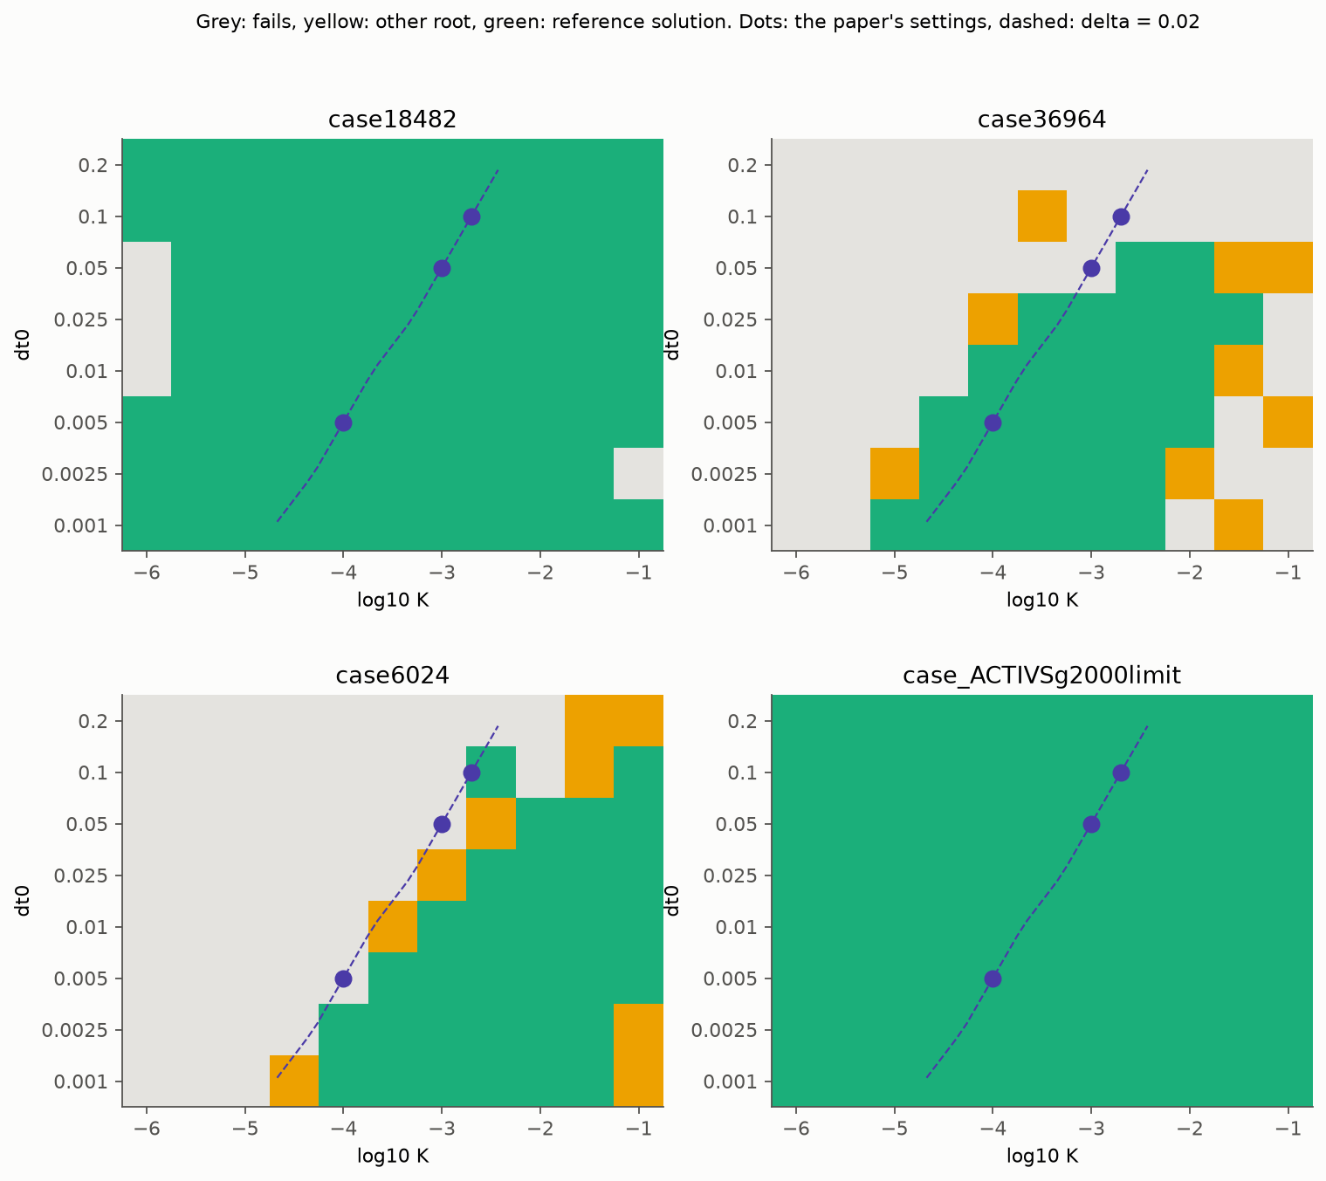
Studies from our proposal presentation
Power method and shifted inverse iteration: |λ|min of J is 4×10⁻⁴ to 6×10⁻³; the shift δ = 0.02 lowers the eigenvalue ratio from 1.2×10⁸ to about 2×10⁶
Sweep over (K, Δt₀), right: the method works in a band of constant δ = K/Δt₀
Golden-section search for δ: 23 of 25 new grids solved instead of 19, but costs about 21 solves
Our own Gauss / LU with pivoting: same iterates to 5×10⁻¹², but 424 s vs 0.04 s (no sparsity)
Lima-Silva & Freitas (2024): reproduction and improvements
18
Notes:
These studies were stated in our proposal presentation. In the maps, green is the reference root, yellow another root and grey a failure; the dots are the paper's settings and the dashed line is delta = 0.02. On case36964 no setting with dt0 of 0.1 or more works, which explains a failure the paper reports without explanation. Inverse iteration matched SciPy's ARPACK on 33 of 34 grids. A rule predicting delta from the smallest eigenvalue did not work.

Slide 18
Conclusions
The paper's first BE step is a Newton step on J + δI, which is why it works where Newton fails
We reproduced the method and its tables from scratch in Python
A converged run is not always the intended root; we check every run against a reference
Predictor-corrector, optimal multiplier and Richardson step control raise the solved runs from 127 to 152 to 156 of 170
Backward Euler remains the cheapest integrator, even with error control
Thank you. Questions?
19
Notes:
The paper turns a hard root-finding problem into a stiff ODE and follows it with two backward Euler steps, which act as a regularised Newton step. We reproduced it, found that a small residual does not guarantee the right root, and improved it with three classical numerical techniques.

